Slide 1

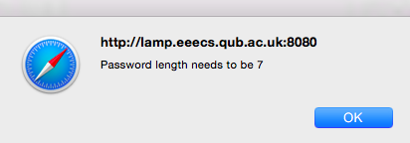
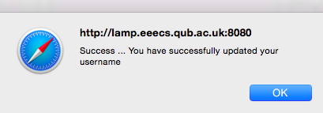
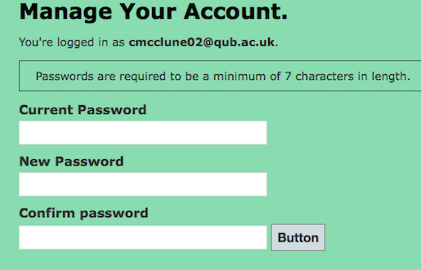
Manage Account – Reset Password
The version and © information omitted
Validation fix
Miscommunication
Inconsistency
Majority of defects cosmetic → moderate

